Slide 1

DataPolish

Slide 2
Criteria of Evaluation
Cost
Ease of use
Features
Customer feedback

Slide 3



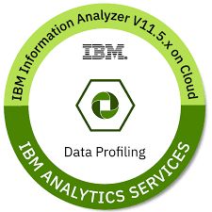

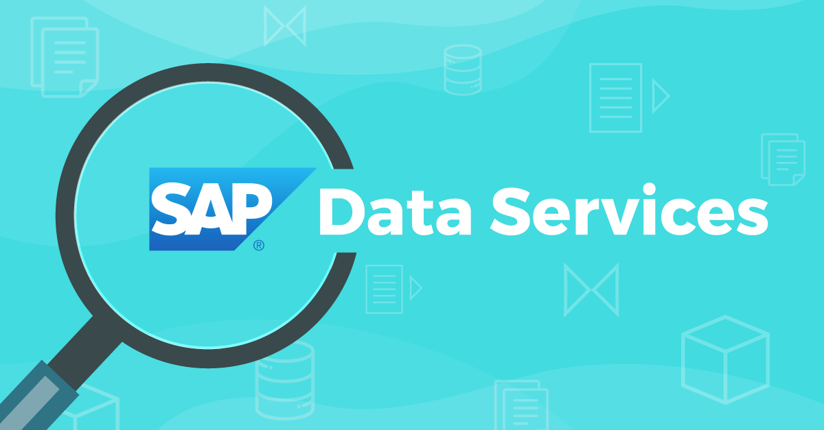
COST
Free
Paid

Slide 4
COST
DataPolish
Free
Paid

Slide 5


Slide 6

STUDENT – EASE OF USE
EASY
HARD

Slide 7
STUDENT – EASE OF USE
DataPolish
EASY
HARD

Slide 8

Features

Slide 9
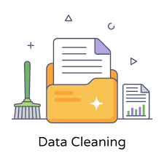
Features

Slide 10

Features
Data Transforming

Slide 11

Features
Data Transforming
Data Exploration

Slide 12
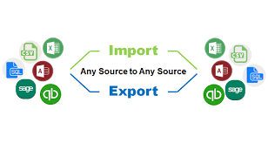
Features
Data Transforming
Data Exploration
Data Import & Export

Slide 13
Common Features
Data Standardization
Data Validation
Data Integration
Data Matching
Data Enrichment
Address Verification/Cleaning
Text Data Processing
Data Profiling
ETL Capabilities
Data Cleansing

Slide 14
Unique Features
Data Quality Monitoring:
Undo/Redo Stack:
Data Governance:
Parallel Processing:.
Geocoding:

Slide 15

Customer feedback

Slide 16
Customer feedback
4 Interviews

Slide 17
Customer feedback
DataPolish
4 Interviews
Loved DataPolish

Slide 18
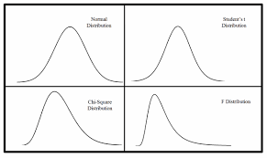

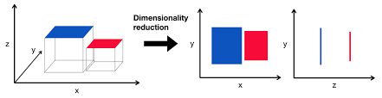
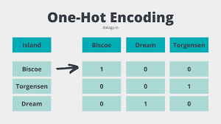
Customer feedback
DataPolish
4 Interviews
Loved DataPolish
Idea Generators

